Slide 1
DOMAIN MODELS

Slide 2
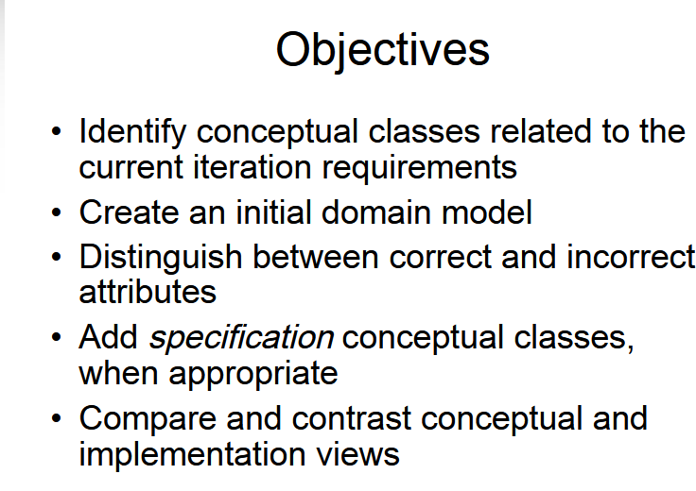

Slide 3
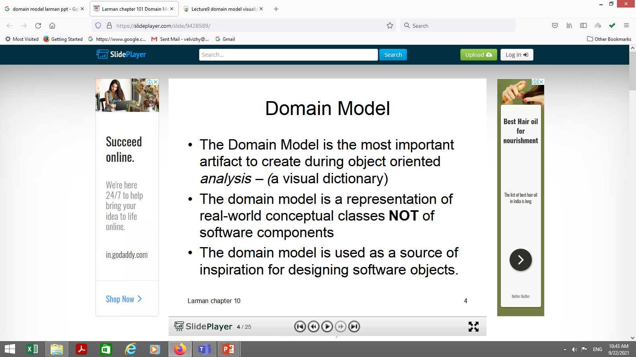

Slide 4
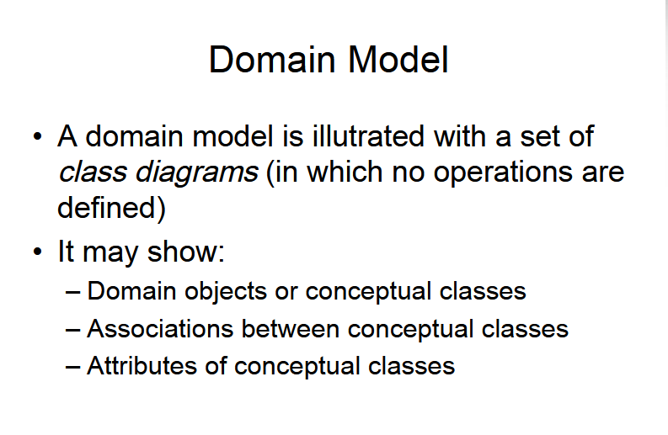

Slide 5
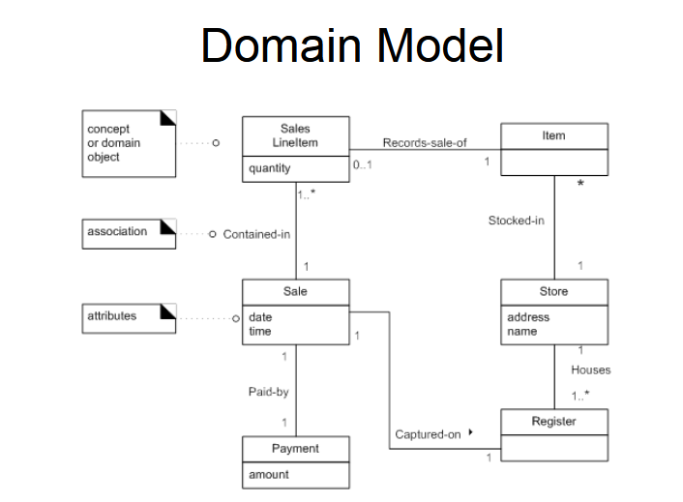

Slide 6
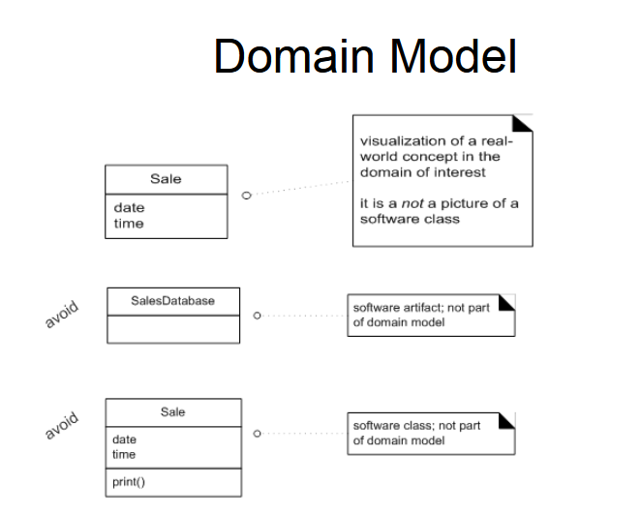

Slide 7
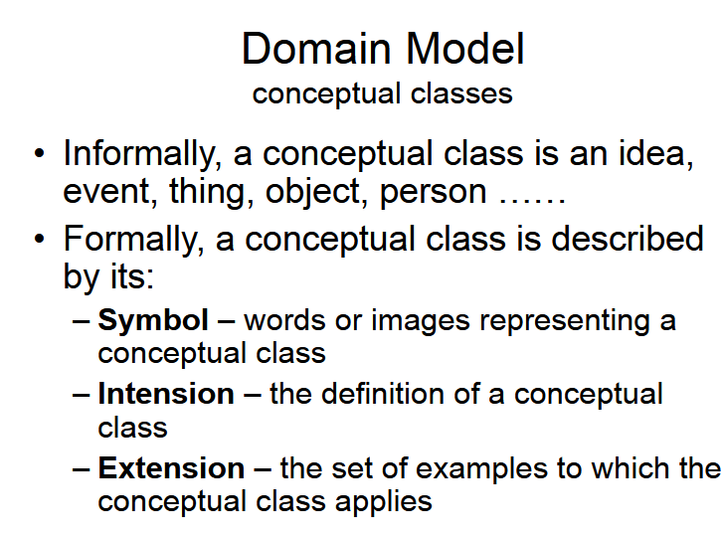

Slide 8
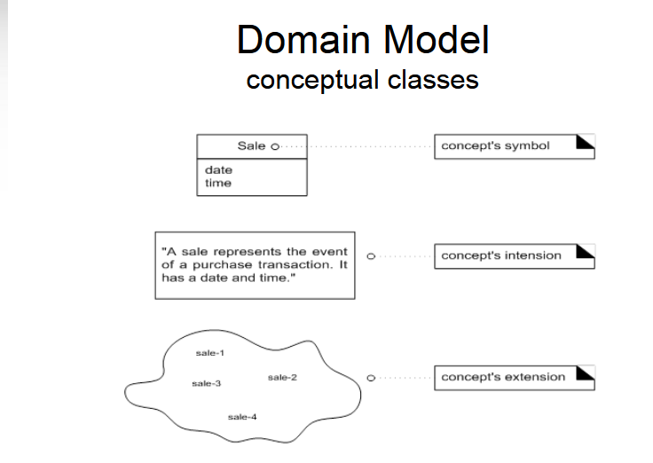

Slide 9
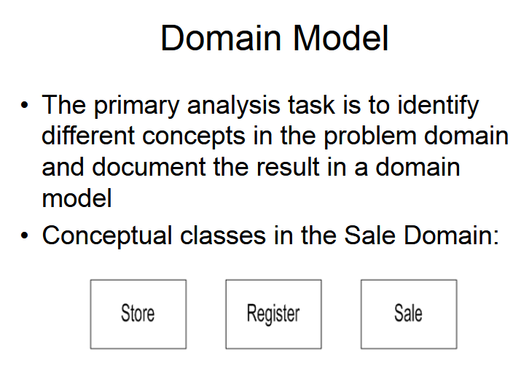

Slide 10
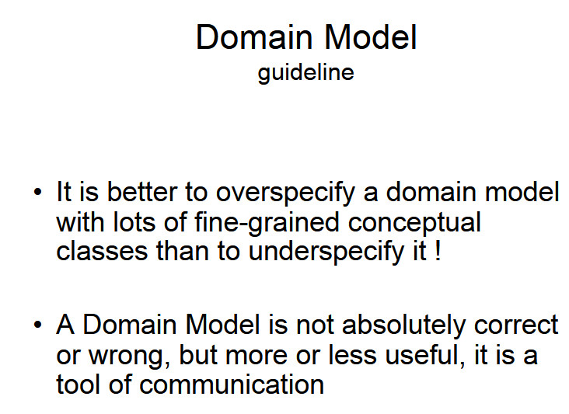

Slide 11
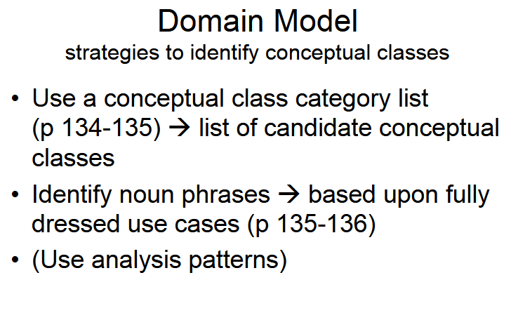

Slide 12
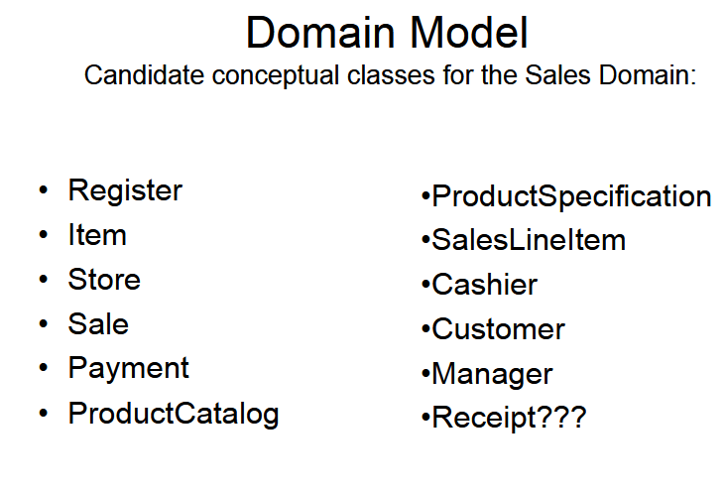

Slide 13
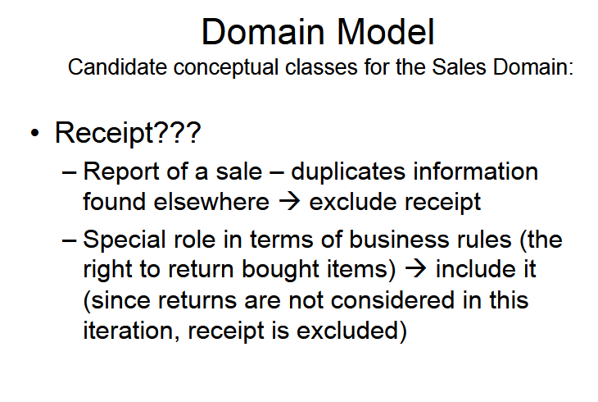

Slide 14
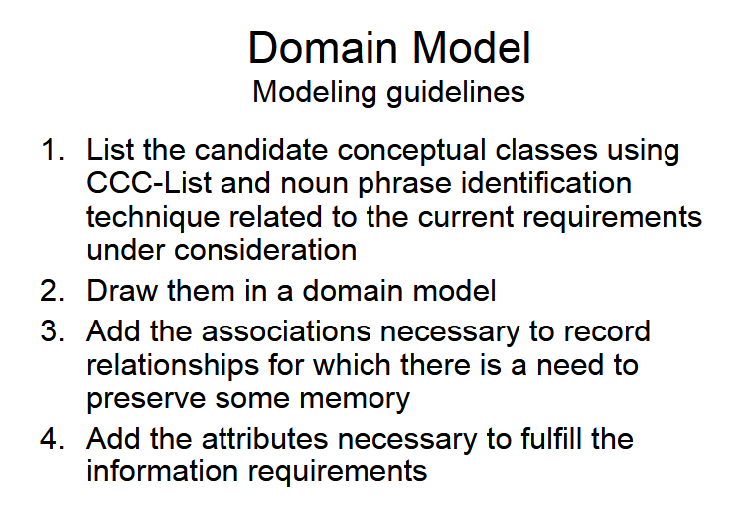

Slide 15
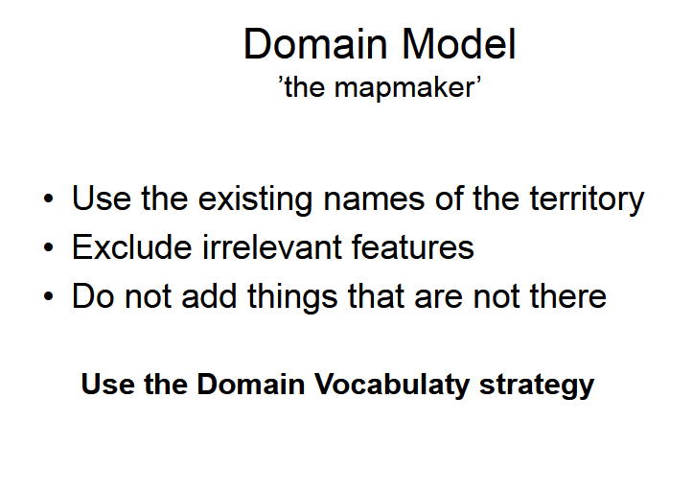

Slide 16
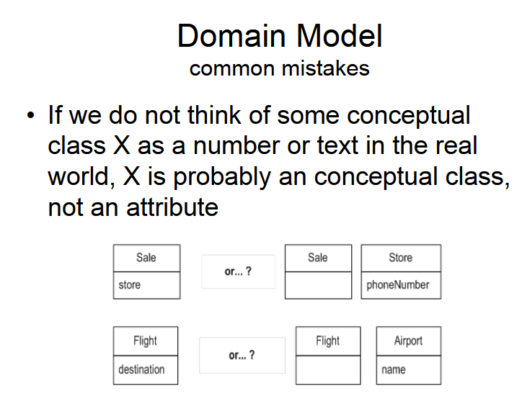

Slide 17
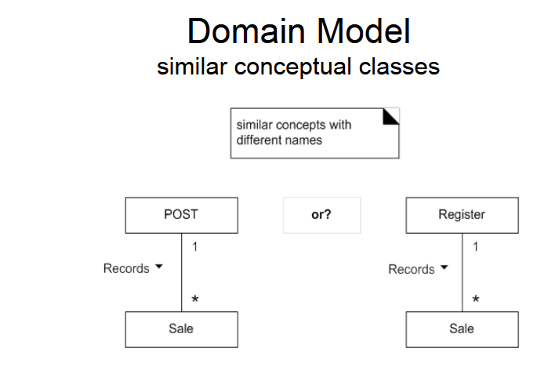

Slide 18
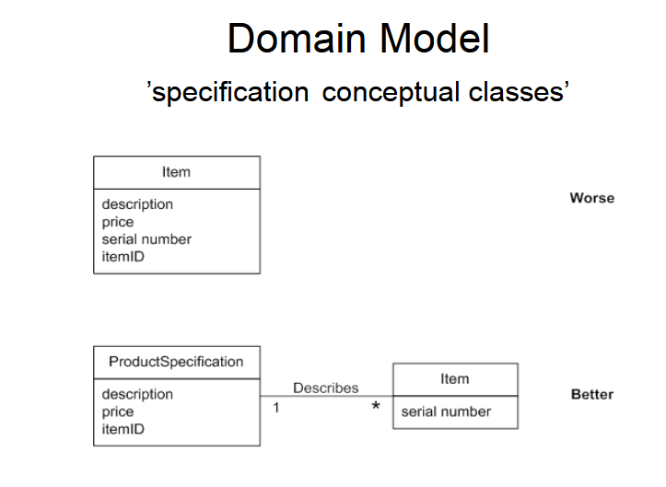

Slide 19
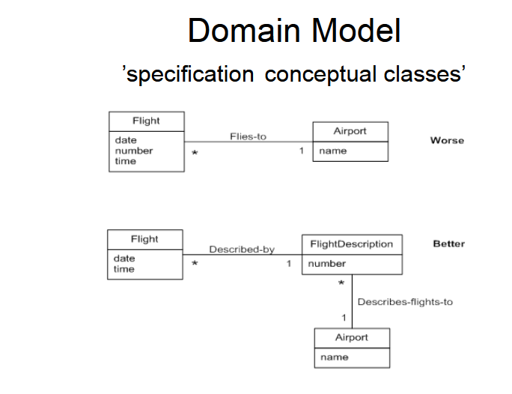

Slide 20
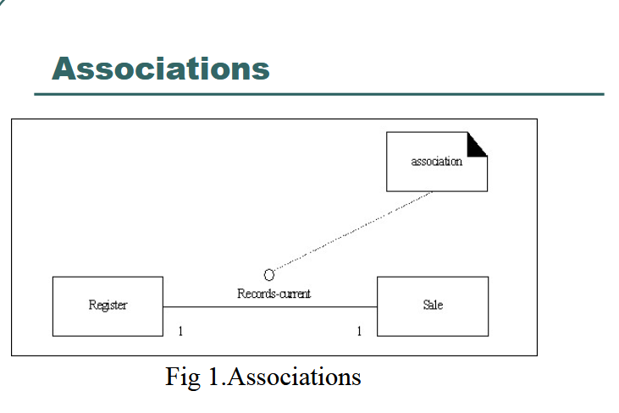

Slide 21
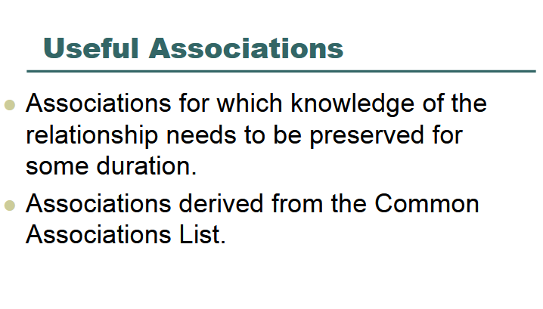

Slide 22
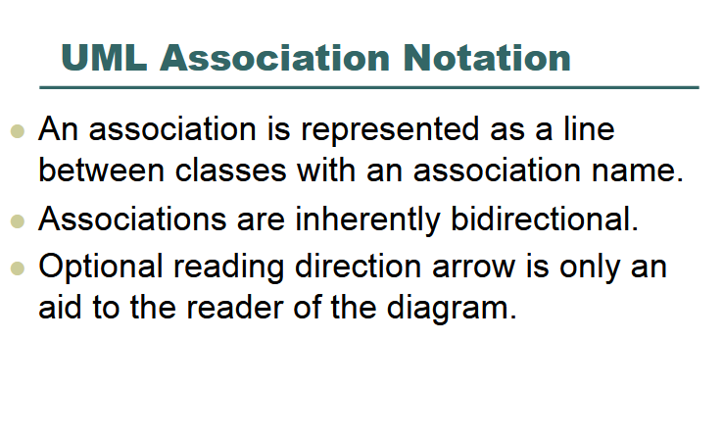

Slide 23
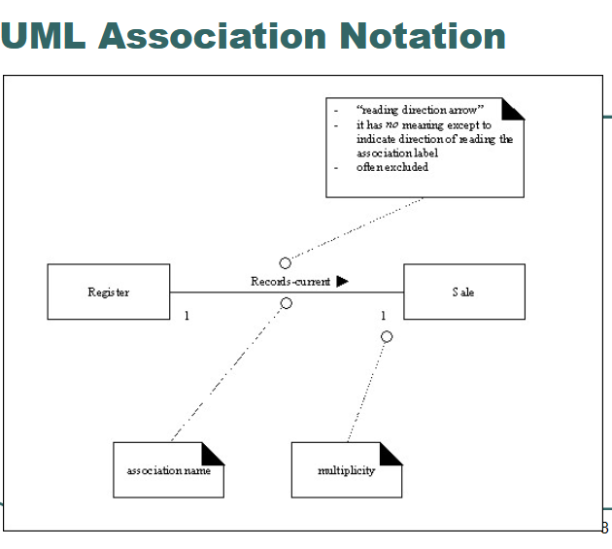

Slide 24
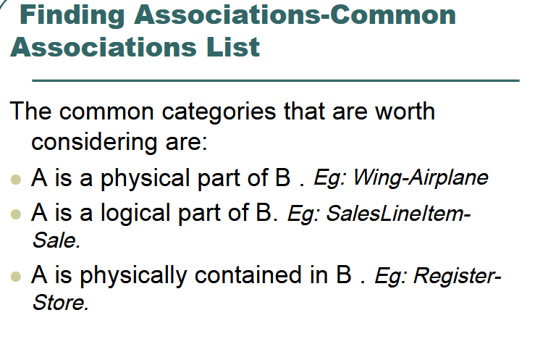

Slide 25
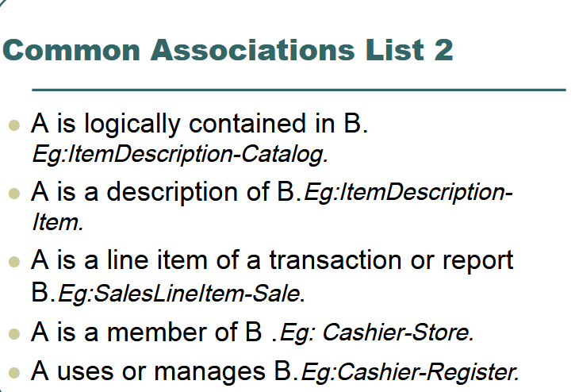

Slide 26
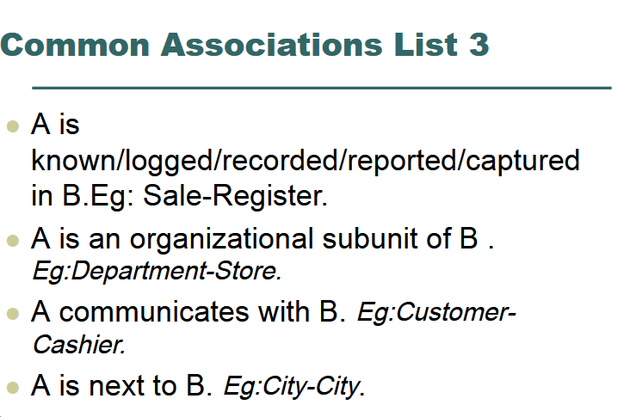

Slide 27


Slide 28
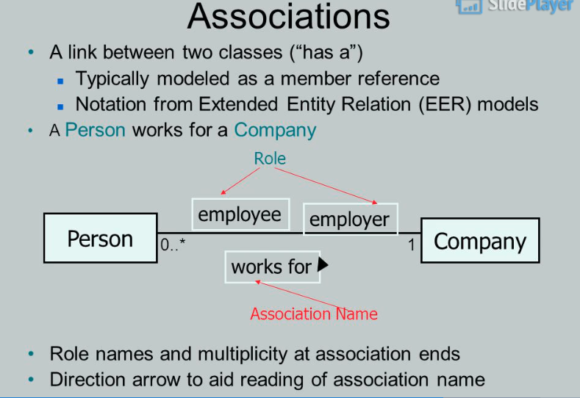

Slide 29
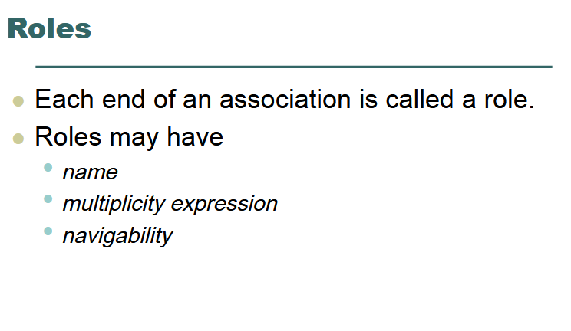

Slide 30
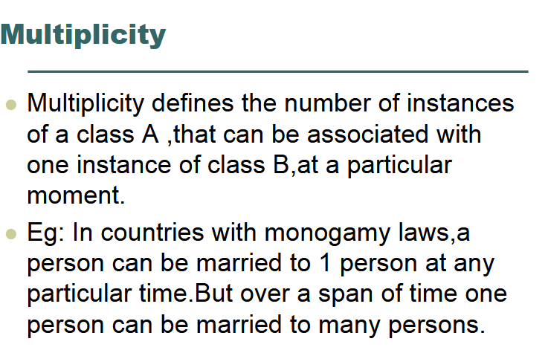

Slide 31
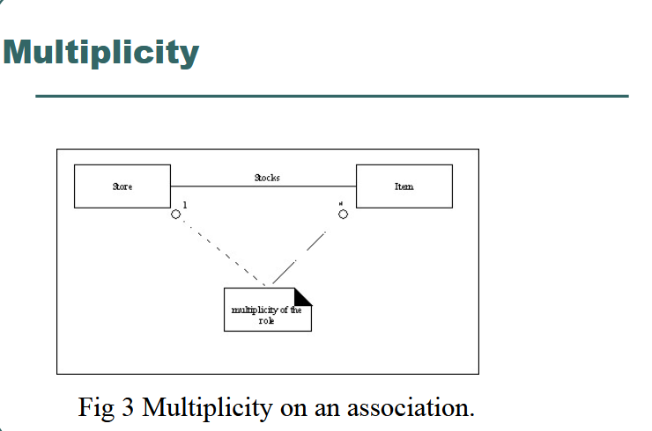

Slide 32
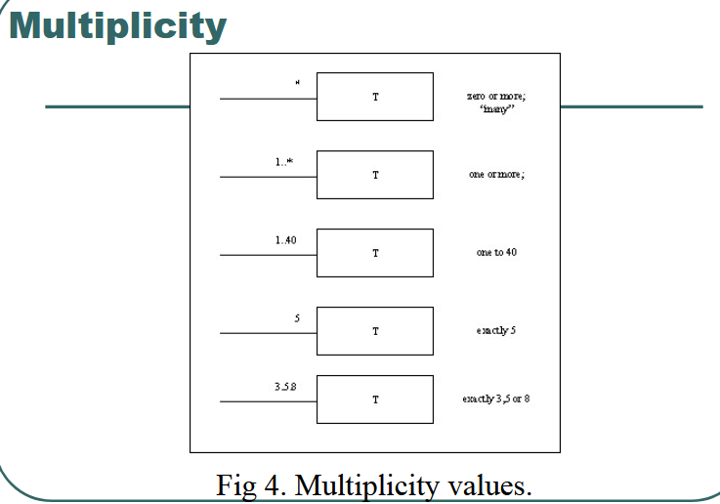

Slide 33
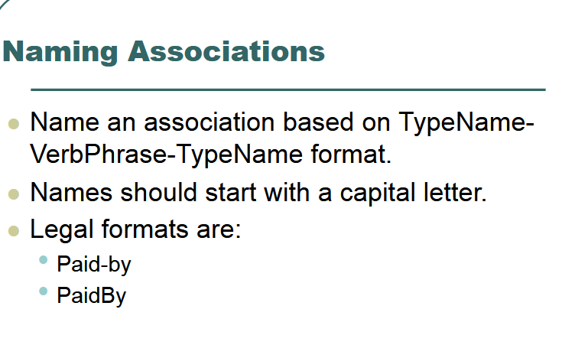

Slide 34
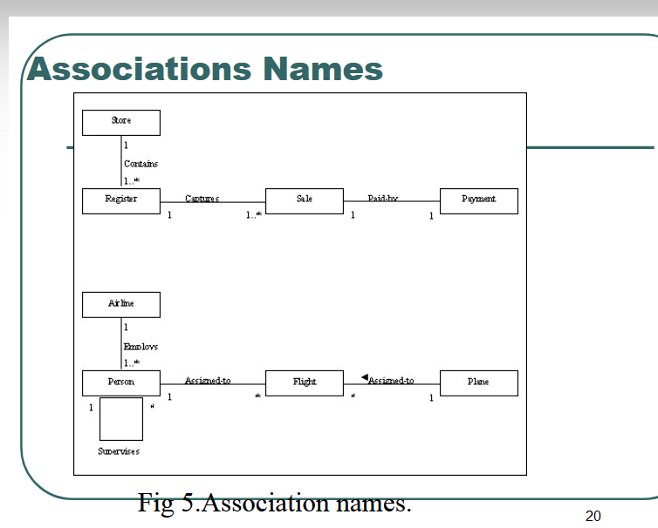

Slide 35
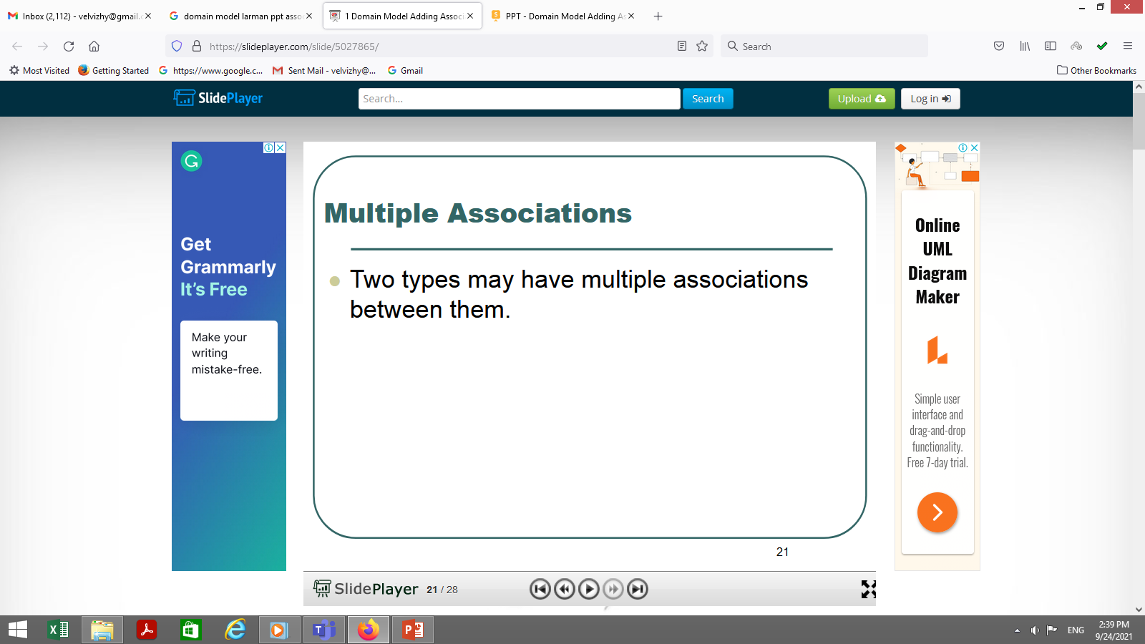

Slide 36
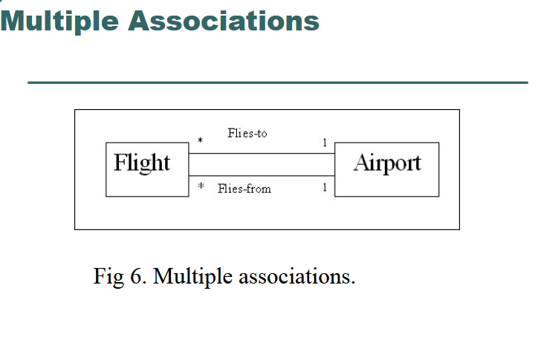

Slide 37
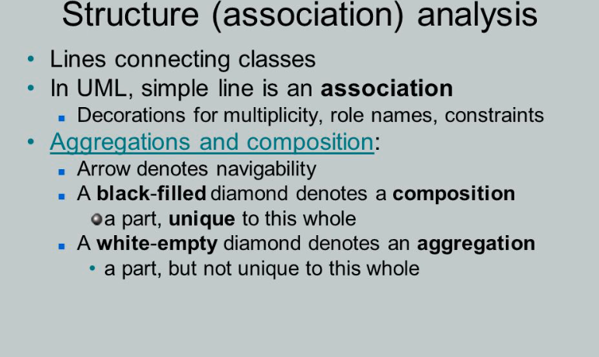

Slide 38
Association vs Aggregation vs Composition
The question "What is the difference between association, aggregation, and composition" has been frequently asked lately.
Aggregation and Composition are subsets of association meaning they are specific cases of association. In both aggregation and composition object of one class "owns" object of another class. But there is a subtle difference:
Aggregation implies a relationship where the child can exist independently of the parent. Example: Class (parent) and Student (child). Delete the Class and the Students still exist.
Composition implies a relationship where the child cannot exist independent of the parent. Example: House (parent) and Room (child). Rooms don't exist separate to a House.

Slide 39
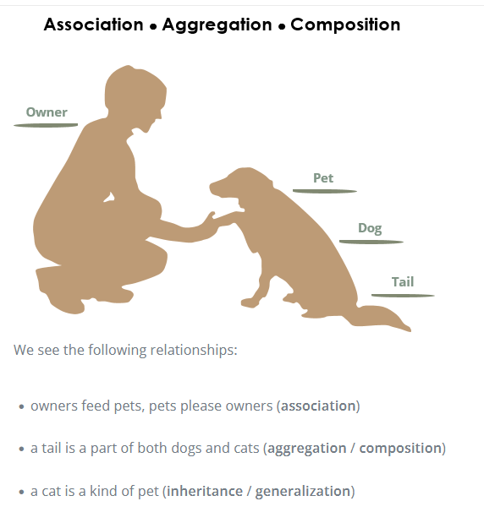

Slide 40
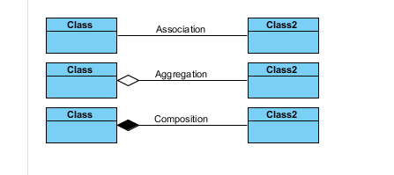

Slide 41
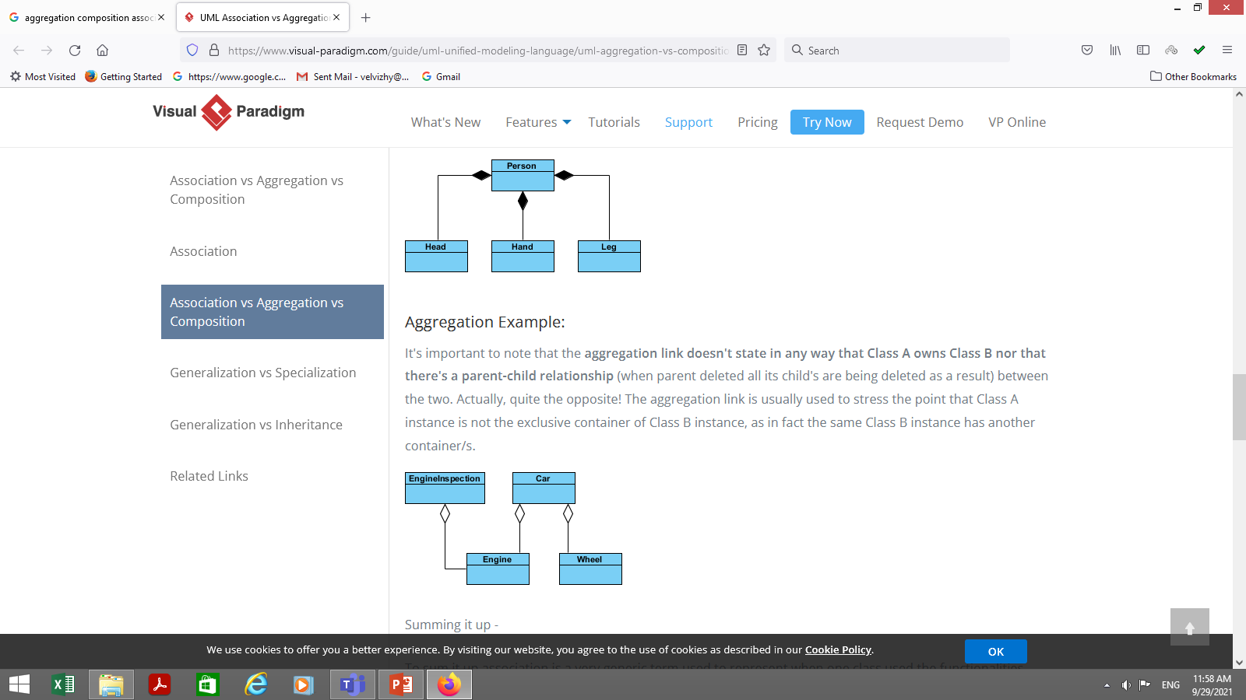
Composition Example:
We should be more specific and use the composition link in cases where in addition to the part-of relationship between Class A and Class B - there's a strong lifecycle dependency between the two, meaning that when Class A is deleted then Class B is also deleted as a result

Slide 42
Aggregation Example:
It's important to note that the aggregation link doesn't state in any way that Class A owns Class B nor that there's a parent-child relationship (when parent deleted all its child's are being deleted as a result) between the two. Actually, quite the opposite! The aggregation link is usually used to stress the point that Class A instance is not the exclusive container of Class B instance, as in fact the same Class B instance has another container/s.

Slide 43
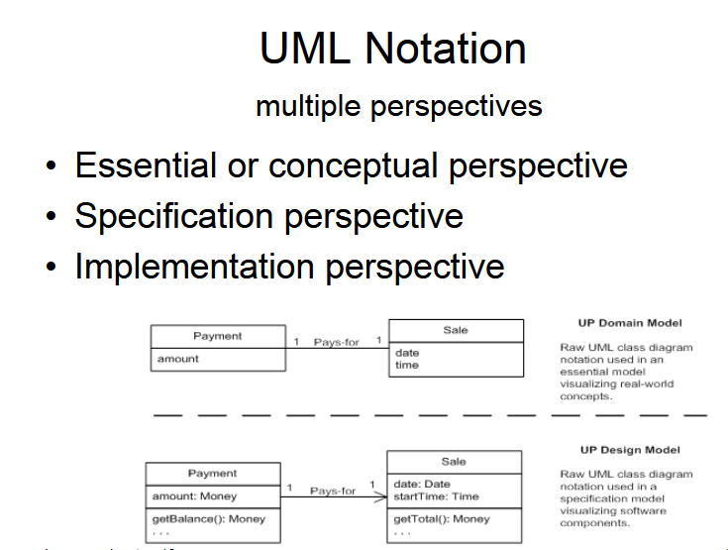

Slide 44
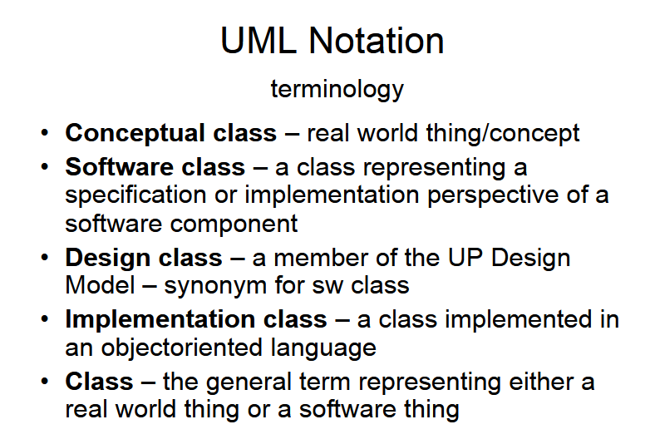

Slide 45
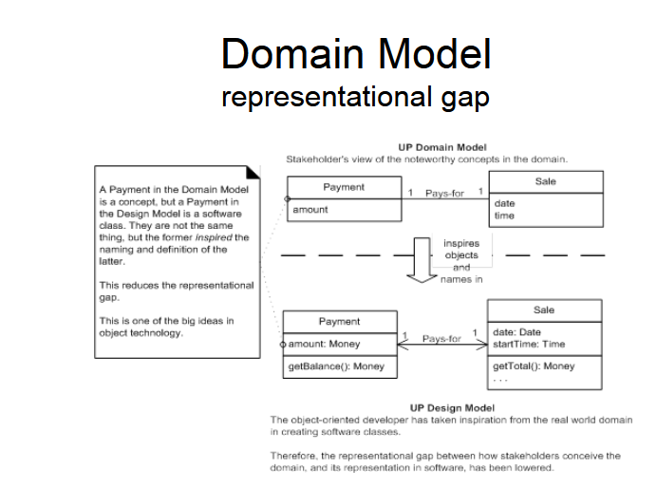

Slide 46
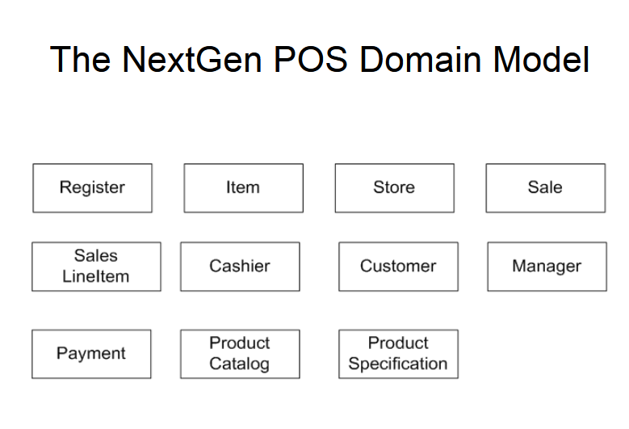

Slide 47
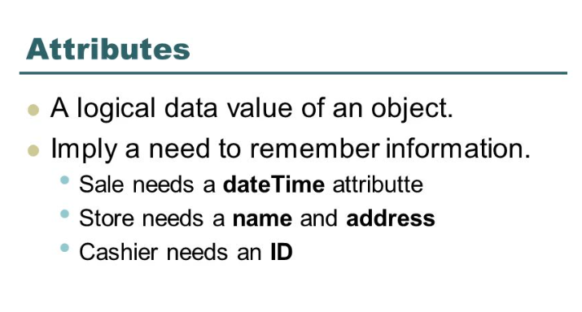

Slide 48
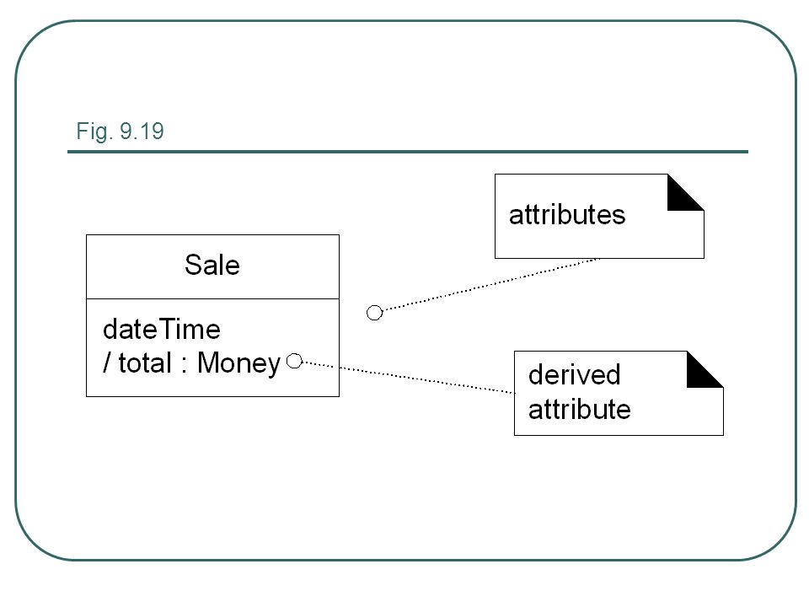
Attribute Notation

Slide 49
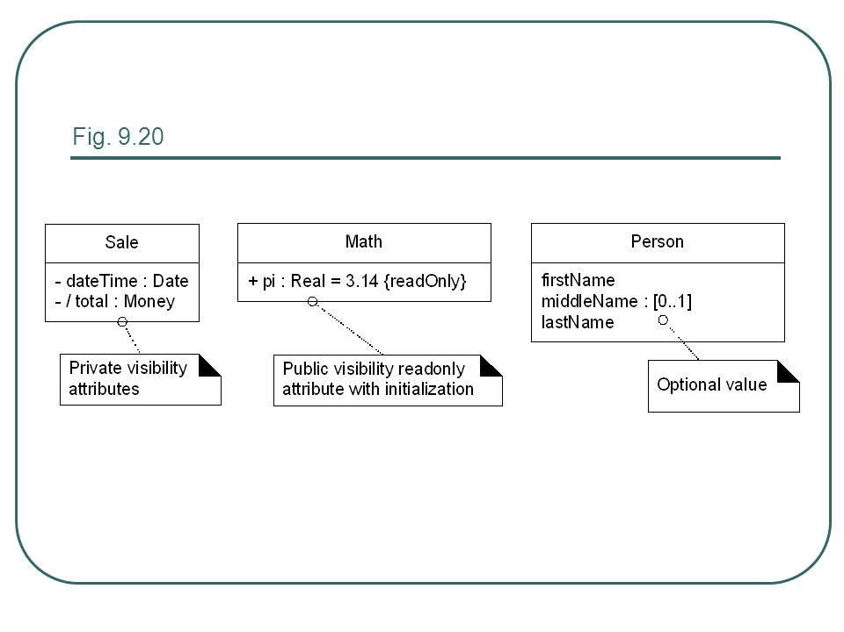
More notation: visibility name:type multiplicity=default{property-string}

Slide 50
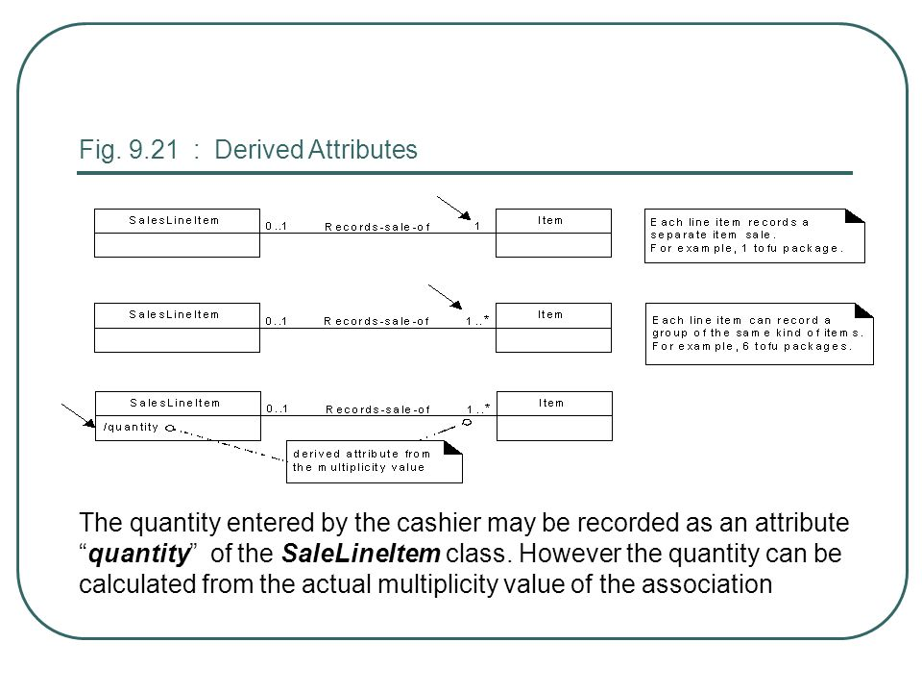
The quantity entered by the cashier may be recorded as an attribute “quantity” of the SaleLineItem class. However the quantity can be calculated from the actual multiplicity value of the association

Slide 51
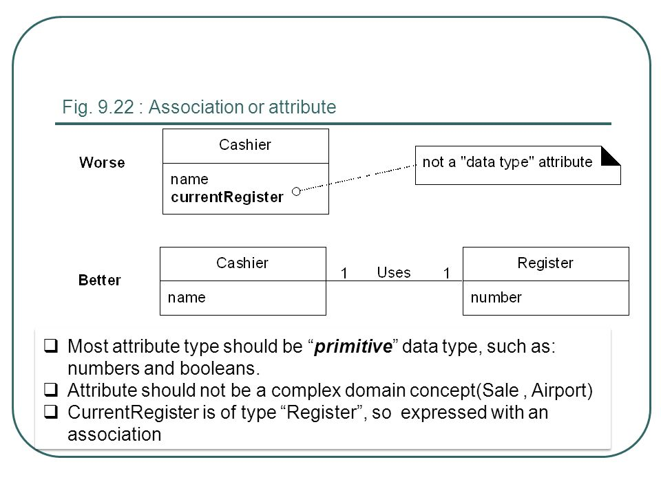
Most attribute type should be “primitive” data type, such as: numbers and booleans. Attribute should not be a complex domain concept(Sale , Airport) CurrentRegister is of type “Register”, so expressed with an association

Slide 52
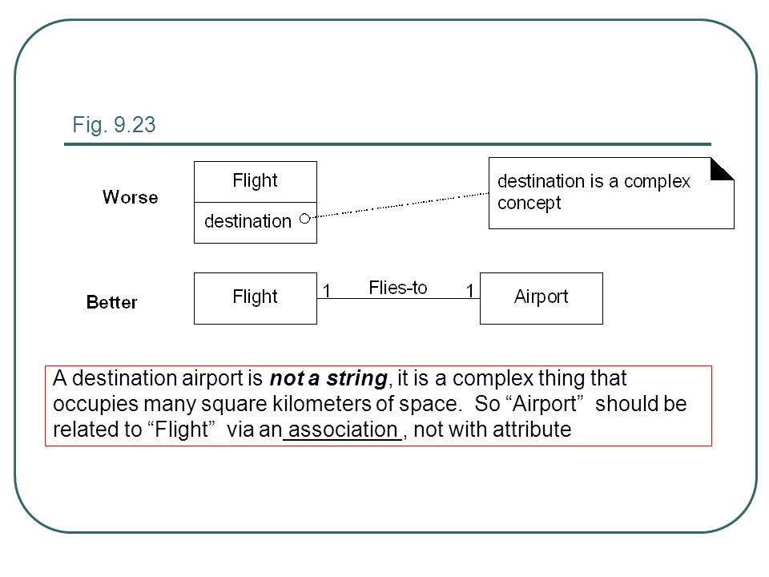
A destination airport is not a string, it is a complex thing that occupies many square kilometers of space. So “Airport” should be related to “Flight” via an association , not with attribute

Slide 53
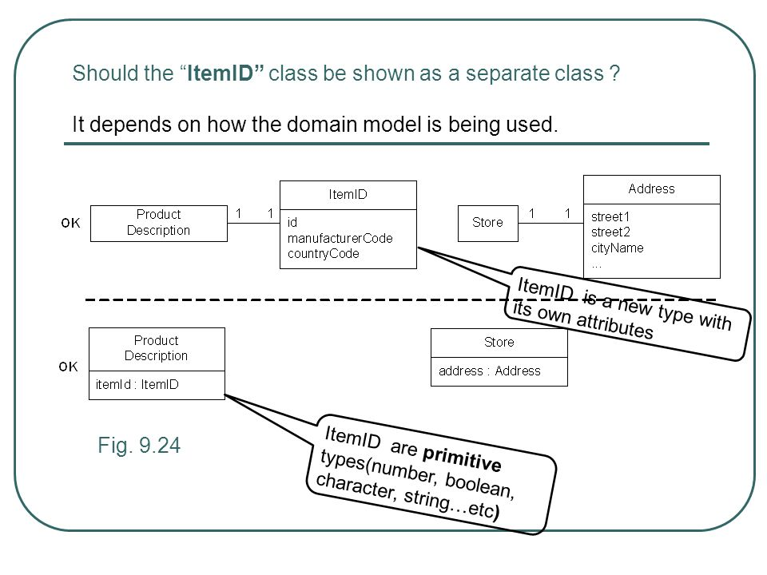
Should the “ItemID” class be shown as a separate class ? It depends on how the domain model is being used. ItemID is a new type with its own attributes Fig. 9.24 ItemID are primitive types(number, boolean, character, string…etc)

Slide 54
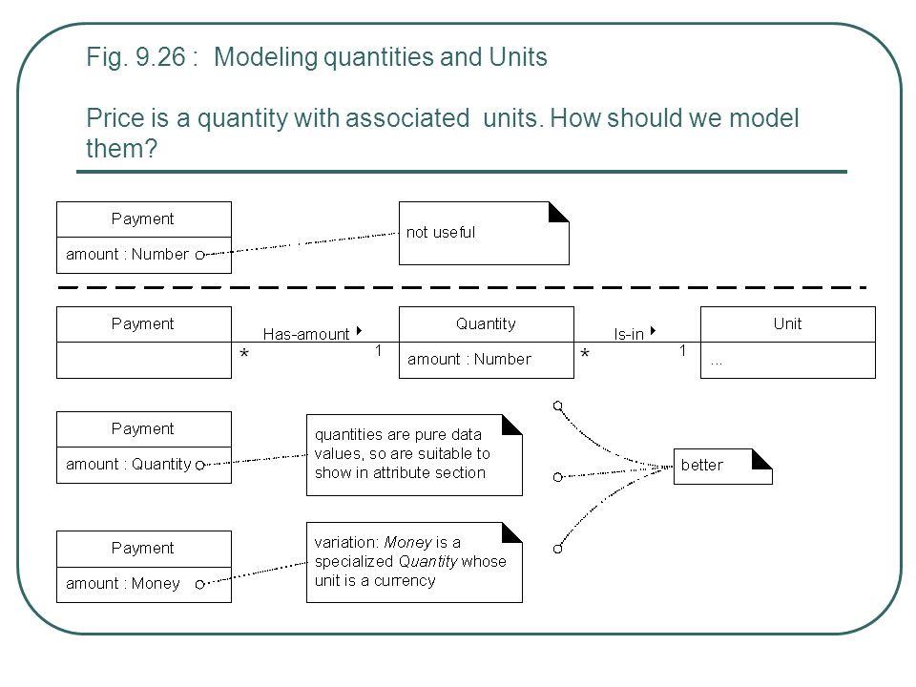

Slide 55

A Common Mistake when modeling the domain- Classes or Attributes? Rule: If we do not think of a thing as a number or text in the real world, then it is probably a conceptual class. If it takes up space, then it is likely a conceptual class. Examples: Is a store an attribute of a Sale ? Is a destination an attribute of a flight ?

Slide 56


Slide 57
Problem definition: Consider a system for a simple mobile phone. The phone can receive calls and call other phone numbers. It offers its owner a personal phone book to store names and phone numbers. The phone book can be dynamically updated. The phone also manages a complete log of all incoming and outgoing calls and helps its owner to remember unanswered calls.
Find classes and attributes for the mobile phone system.

Slide 58
Problem definition:
Consider a smartphone system with the following key features:
The phone can receive calls, call other phone numbers. It offers its owner a personal phone book to store names and phone numbers. The phone book can be dynamically updated. The phone also manages a complete log of all incoming and outgoing calls and helps its owner to remember unanswered calls. It also have Internet connectivity, a mobile browser, the ability to sync more than one email account to a device, embedded memory, a hardware or software-based QWERTY keyboard, wireless synchronization with other devices, such as laptop or desktop computers, the ability to download applications and run them independently, support for third-party applications, the ability to run multiple applications simultaneously, touchscreen, Wi-Fi, digital camera, typically with video capability, gaming, messaging, GPS, camera.
Find classes and attributes for the smartphone system.

